Slide 1


Chapter 9/Part 2
Animal transport

Slide 2
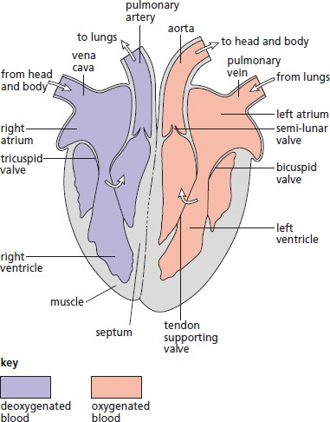

Internal structure of the heart
If the heart is cut open vertically, it shows four chambers.
Two upper chambers called atria or auricles, which receive blood from the veins.
Two lower chambers called ventricles. Blood flows into the ventricles from the atria, and is then squeezed out into the arteries.
The atria and ventricles are separated by the atrio-ventricular
valves.
The one on the left is the bicuspid or mitral valve.
The one on the right is the tricuspid valve.
The left side of the heart is completely separated from the
right side by a wall of muscle called septum.

Slide 3

The blood vessels connected to the heart
Superior vena cava: collects deoxygenated blood from the head and upper limbs and transports it to the right atrium.
Inferior vena cava: collects deoxygenated blood from the lower parts of the body and transports it to right atrium.
Pulmonary artery: carries deoxygenated blood from the right ventricle to the lungs.
Pulmonary veins: carry oxygenated blood from lungs to the left atrium.
Aorta: carries oxygenated blood from left ventricle to all body parts.
Coronary arteries: branch from aorta to supply the heart muscles with oxygen and food. Coronary arteries
lead to coronary veins, which carry wastes of metabolism, such as carbon dioxide.

Slide 4
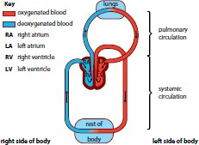
The mammalian cardiovascular system as a closed double circulation
It is a closed circulatory system as blood flows inside vessels, and always remains within these vessels.
It is a double circulatory system because blood passes through the heart twice during one complete circuit, one during pulmonary circulation and the second during the systemic circulation.
Pulmonary circulation: circulation through the lungs. Blood flows from heart to lungs back to heart.
Systemic circulation: circulation round the rest of the body. Blood flows from heart to the body parts, except the lungs, and back to the heart.

Slide 5
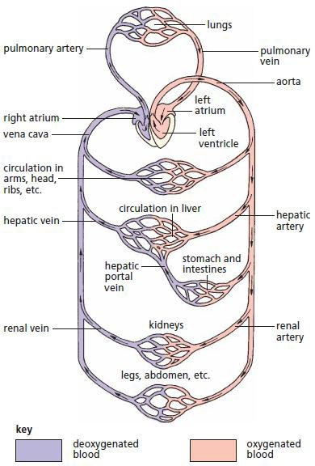
Advantages of double circulation
Oxygenated blood kept separate from deoxygenated blood.
Blood pressure in pulmonary circulation is lower than systemic circulation.
Blood pressure is maintained.

Slide 6
The cardiac cycle
Cardiac cycle: is the sequence of events, which makes up one heartbeat.
At rest, the heart beats about 72 times per minute, so each cycle lasts about 0.83 seconds.

Slide 7
The cardiac cycle consists of:
Atrial systole or contraction of the atria. The pressure developed is enough to force blood in the atria down through the atrio-ventricular valves into the ventricles.
Note: the blood from the atria does not go back into the pulmonary veins or the venae cavae, because these have semilunar valves which close to prevent backflow.
Ventricular systole or contraction of ventricles. A great pressure develops which pushes the atrio-ventricular valves shut, preventing back flow of blood into the atria. Instead, the blood moves upwards into the aorta and the pulmonary artery, pushing open the semilunar valves in these vessels.
Complete cardiac diastole or relaxation of the atria and ventricles. The high-pressure blood in arteries may flow back into the ventricles, but as the blood fills the cusps of semilunar valves, they close and prevent this back flow of blood.

Slide 8
The differences in the thickness of the walls of the different chambers in terms of their functions
The walls of the ventricles are much thicker than the walls of the atria, because the
ventricles need to develop much more force when they contract. Their contraction has to
push the blood out of the heart and around the body.
The walls of the atria are thin, because as they contract they develop small force, which is enough to push blood down through the atrio-ventricular valves into the ventricles.
The thickness of the muscular wall of the left ventricle is much greater than that of the right.
For the right ventricle, the force required is relatively small, as the blood goes only to the lungs (short distance), which are very close to the heart.
The left ventricle has to develop sufficient force to push blood around the rest of the body (long distance).

Slide 9
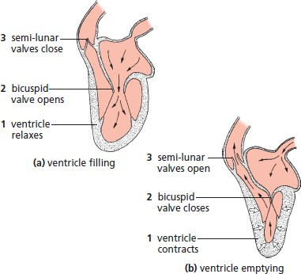
How the heart valves function?
Atrio-ventricular valves
These are the bicuspid and tricuspid valves. During atrial systole the pressure of blood is higher in the atrium than in the ventricle and so forces the valves open.
During ventricular systole the pressure of blood is higher in the ventricle than in the atrium, which pushes up against the cusps of the valve making it close.
Note: Contraction of papillary muscles, attached to the valve by tendons, prevents the valve from being turned inside-out.

Slide 10
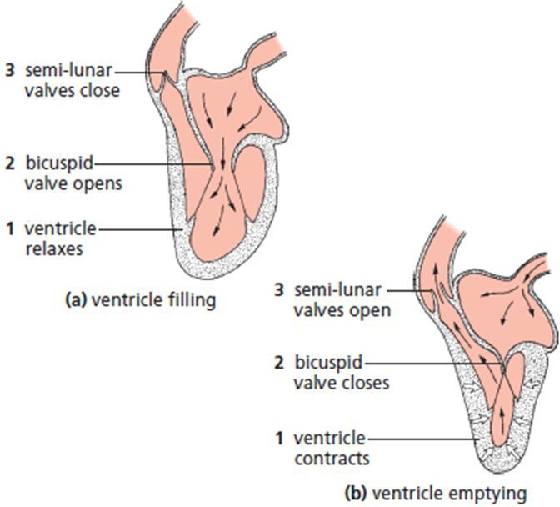
Semilunar valves
These are found at the exits of the heart, in the aorta and pulmonary artery. During ventricular systole the pressure of the blood forces the valves open.
During ventricular diastole the pressure of blood in the arteries is higher than in the ventricles, which pushes into the cusps of the valves, making them shut.

Slide 11
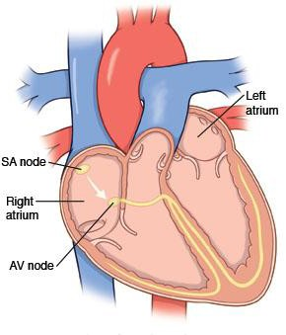
Control of heart beat
The heart beat is initiated by the pacemaker.
Pacemaker: a small group of specialized muscle cells at the top of right atrium. It receives two sets of nerves from the brain to regulate the number of heart beats.

Slide 12

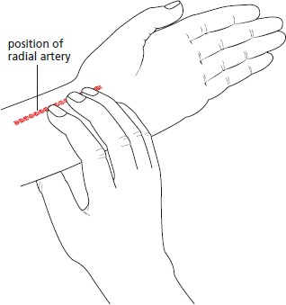
Pulse
Pulse: it is the rhythmic flow of blood in arteries.
Pulse can be measured by pressing on neck arteries or radial arteries (use your finger except the thumb)

Slide 13
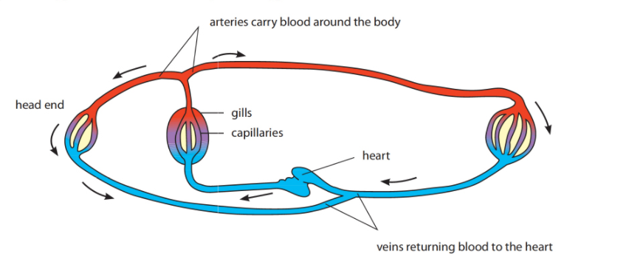
Single circulation in Fish

Slide 14
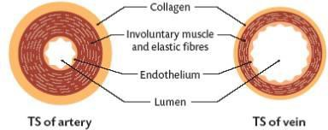
Blood vessels - Arteries
Definition: an artery is a blood vessel which carries blood away from the heart to the tissues.
Adaptations of structure to function
Thick walls withstand the high blood pressure;
Elastic fibers stretch and recoils as the blood is forced out of the heart;
Narrow lumen with smooth endothelium to
reduce resistance to blood flow;
Blood is rich in oxygen, low in carbon dioxide (except in pulmonary artery);
No valves, blood is at high pressure;
Many circular muscles in small arteries can narrow or widen the artery and control the blood in according to body’s needs.

Slide 15
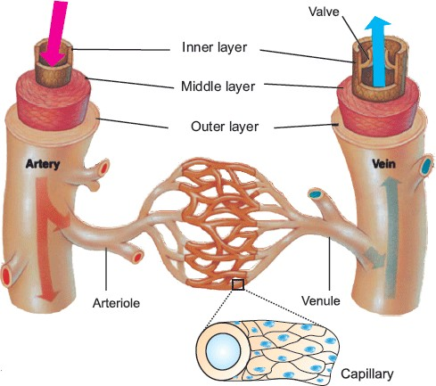
Blood vessels - Veins
Definition: a vein is a blood vessel which carries blood from the tissues to the heart.
Adaptations of structure to function
Thin walls as the blood is at low pressure;
Valves prevent the backflow of blood;
Blood at low pressure, but nearby muscles squeeze the veins and help push blood back towards the heart;
Wide lumen and smooth endothelium reduce resistance to flow of blood;
Blood is low in oxygen, high in carbon dioxide (except in the pulmonary vein.

Slide 16
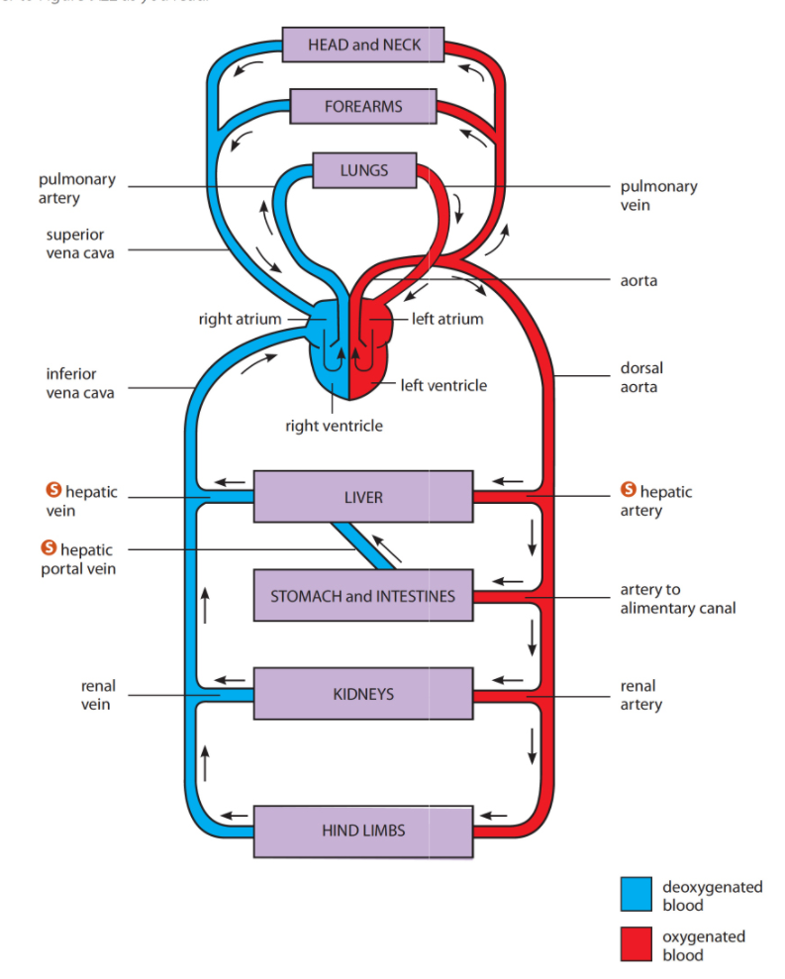
Arteries and Veins of the Human Circulatory System

Slide 17
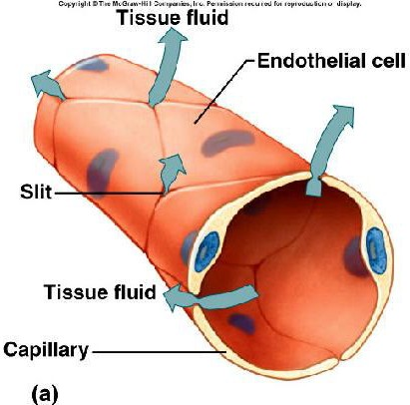
Blood vessels - capillaries
Definition
Are the smallest blood vessels, considered as
ends of arteries and beginnings of veins.
Adaptation
The thin wall, one cell thick to facilitate diffusion of different materials from and to blood.
Contain fine gaps between individual cells for exchange of materials with the body tissues (capillaries in the brain do not have such gaps).

Slide 18
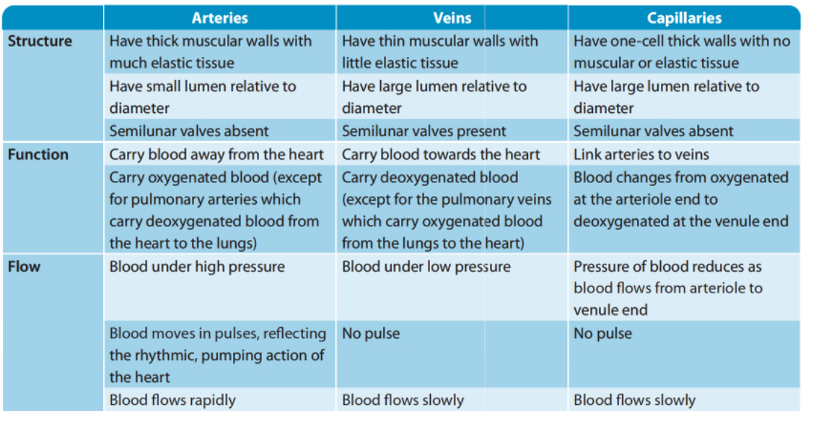
Comparison between blood vessels

Slide 19
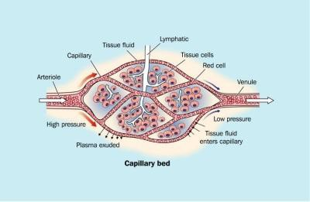
Transport function of tissue fluid
The pressure in capillaries is much greater than in the tissues so most components of plasma filtrate outside capillaries (The filtrate is known as tissue fluid) to submerge the body cells to transport (provide them with their) requirements and to carry away their waste products.

Slide 20
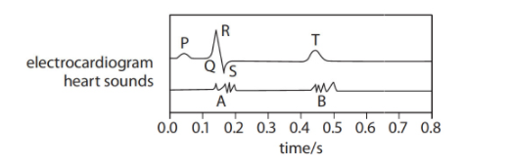
Electrocardiogram ECG
Phases of ECG:
P: contraction of atria
QRS: shows the activity during the contraction of ventricles
T: Relaxation of the ventricles
A: loud “lub” sound…………ventricles contract
B: softer “dub” sound……….. Ventricles relax

Slide 21
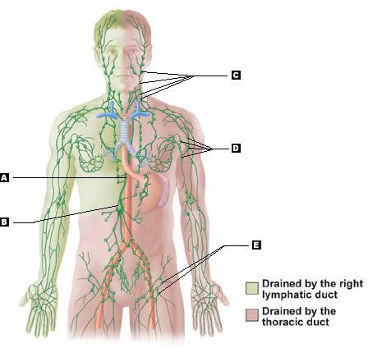
THE LYMPHATIC SYSTEM
The Lymphatic System consists of:
Lymph organs (e.g. spleen)
Lymph (the fluid)
Lymph vessels
Adaptation of Lymphatics
Lymphatics are thin walled vessels with closed ends;
They have gaps in their walls, which allow tissue
fluid to pass through;
They have valves, which prevent back flow of lymph so lymph flows in one direction;
Lymphatics from all parts of body join up to make two large vessels which in turn empty their contents into the blood system.
Note
Lacteals from villi of small intestine (absorb fats) join the lymphatic system.

Slide 22
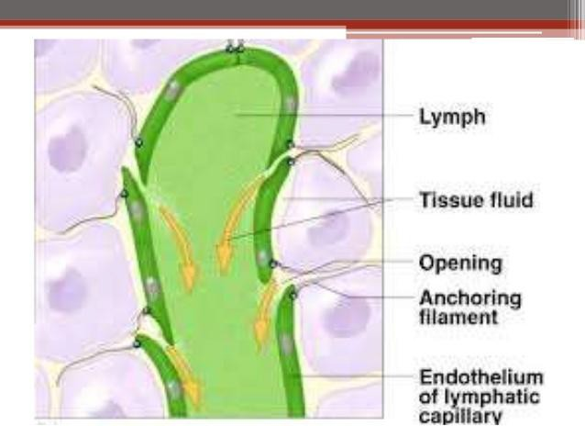
Lymph
The tissue fluid that cannot return back into the capillaries, pass into the lymphatics.
The fluid inside lymphatics is called lymph, so lymph is identical to tissue fluid.
The movement of lymph along the lymphatics is largely caused by the contraction of muscles around the vessels, and kept going in the right directions by valves.
Lymph vessels also have smooth muscle in their walls, which can contract to push the lymph along.
Along lymph vessels, there are swellings called lymph nodes. These are involved in protection against disease because they contain numerous white blood cells.

Slide 23
Functions of lymphatic system
Returns tissue fluid to blood stream;
Prevents the flooding of body cells with tissue fluid;
Defends the body against infection;
Transports Fats.

Slide 24
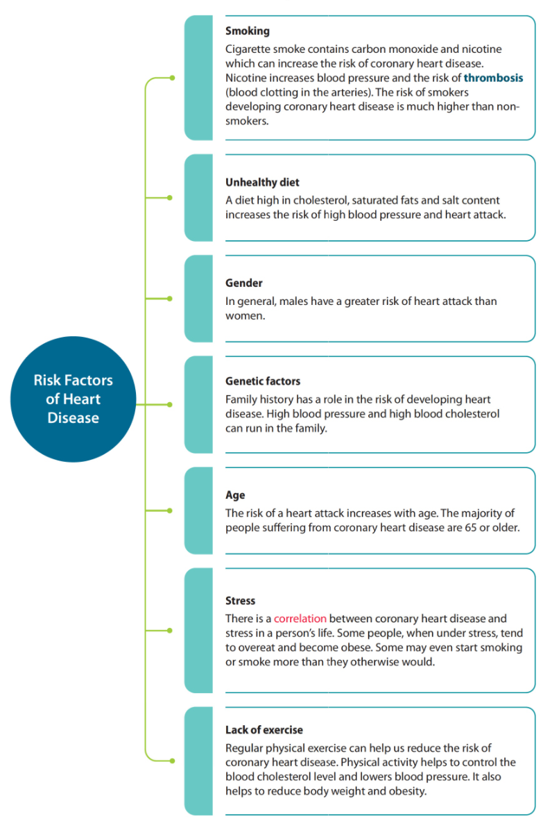

Slide 25
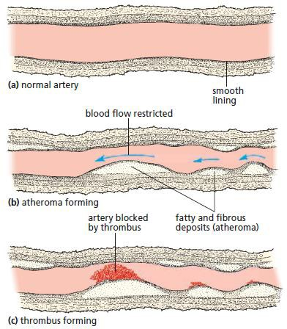
When cholesterol presents in high level in blood usually lay down and forms deposits on the lining of arteries.
The deposits may join up to form a large patch called atheroma. Plaque is formed when calcium and fibers are added. This reduces the diameter of artery. Arteries lose their elasticity forming atherosclerosis.
This increases blood pressure which in turn breaks
part of plaque.
The surface of plaque becomes rough and causes platelets to change fibrinogen in plasma to fibrin, causing a blood clot called thrombus to form.
If the clot blocks a coronary artery, which supplies the muscles of ventricles with blood, it starves the muscles of oxygenated blood and the heart may stop beating. This is a heart attack from coronary thrombosis.

Slide 26
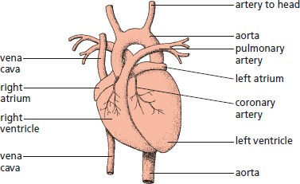
Angina
A pain in the chest which occur during exercise or excretion ( it is due to partially blocked coronary artery by atheroma and reduced blood supply to heart. ) . This is a warning to the person that he or she is at risk and should take precautions to avoid coronary heart attack.

Slide 27
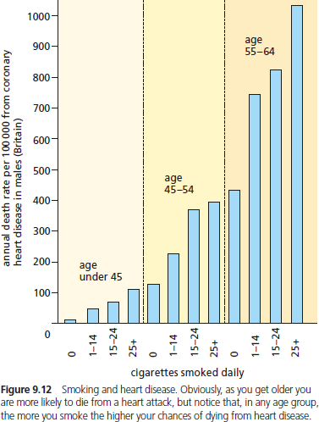
Smoking
Carbon monoxide in tobacco smoke may damage the lining of arteries, which allows atheroma (fat deposits) to form.
Nicotine stimulates the production of adrenaline, this produces an increase in the rate of heart beat and a rise in blood pressure. High blood pressure damages lining of arteries.

Slide 28
Stress
Stress often leads to a raised blood pressure and this increases the rate of atheroma formation.
Lack of exercise:
The heart muscle loses its strength and become less efficient at pumping blood when exercise is not taken. a weak blood flow, resulting from the lack of exercise may cause atheroma to be formed.

Slide 29
The benefits of exercise
During exercise the concentration of carbon dioxide in the blood rises. This is detected by the brain, and nerve messages are sent to:
The heart, which beats more quickly and deeply, pumping more blood into the circulation each minute. (This is aided by
adrenaline during anticipation of an exercise).
The capillary beds, which can be opened up in vital organs or tissues such as muscle, and closed down in non-vital organs such as the gut.
Result
More oxygen and more glucose can be delivered for respiration in working muscles, as well as faster removal
of carbon dioxide.
Long-term benefits of exercise
Increase the size of the heart
Increase the power of heart muscle
Keep artery walls flexible
Increase the size of capillary bed
Increase the breathing rate – more breaths per minute
Increase the tidal volume – more air per breath at rest

